Slide 1

HOTEL BOOKING ANALYSIS
By
HARITHA.P.V

Slide 2
introduction
The data set of hotel booking analysis contains booking information of a City hotel and a Resort hotel from the year 2015-2017.
It includes information such as when the booking was made, length of stay, the number of adults, children, number of available parking spaces, cancellation, reservation, room type and further more.
The main objective behind the project is to explore and analyze data to discover important factors that govern the booking and also to give an insight to hotel management on how to improve the business and performance.

Slide 3
Work flow
Dividing our workflow into 3 steps:
DATA COLLECTION AND UNDERSTANDING,
DATA CLEANING AND MANIPULATION
EXPLORATORY DATA ANALYSIS
(EDA)

Slide 4
DATA COLLECTION AND UNDERSTANDING
The dataset of hotel booking contains total rows 119390 and 32 columns.
Dataset Description
hotel : Name of the hotel (Resort Hotel or City Hotel)
is_canceled : If the booking was canceled (1) or not (0)
lead_time: Number of days before the actual arrival of the guests
arrival_date_year : Year of arrival date
arrival_date_month : Month of month arrival date
arrival_date_week_number : Week number of year for arrival date
arrival_date_day_of_month : Day of arrival date
stays_in_weekend_nights : Number of weekend nights (Saturday or Sunday) spent at the hotel by the guests.

Slide 5
stays_in_week_nights : Number of weeknights (Monday to Friday) spent at the hotel by the guests.
adults : Number of adults among guests
children : Number of children among guests
babies : Number of babies among guests
meal : Type of meal booked
country : Country of guests
market_segment : Designation of market segment
distribution_channel : Name of booking distribution channel
is_repeated_guest : If the booking was from a repeated guest (1) or not (0)
previous_cancellations : Number of previous bookings that were cancelled
previous_bookings_not_canceled : Number of previous bookings not cancelled by the customer prior to the current booking
reserved_room_type : Code of room type reserved
assigned_room_type : Code of room type assigned

Slide 6
assigned_room_type : Code of room type assigned
reserved_room_type : Code of room type reserved
booking_changes : Number of changes/amendments made to the booking
deposit_type : Type of the deposit made by the guest
agent : ID of travel agent who made the booking
company : ID of the company that made the booking
days_in_waiting_list : Number of days the booking was in the waiting list
customer_type : Type of customer, assuming one of four categories
adr : Average Daily Rate, as defined by dividing the sum of all lodging transactions by the total number of staying nights
required_car_parking_spaces : Number of car parking spaces required by the customer
total_of_special_requests : Number of special requests made by the customer
reservation_status : Reservation status (Canceled, Check-Out or No-Show)
reservation_status_date : Date at which the last reservation status was updated

Slide 7
DATA CLEANING AND MANIPULATION
Out of 119390 dataset there are 31994 duplicate rows, so the duplicate values are eliminated in those sets.
There are missing values for 'company', 'agent', 'country', 'children'. For company, agent and children replacing the missing value with 0 and for country replacing the missing value with 'others‘.
Children and agent column are having data type float, but it only include integer value, so changing those into integer.
Addition of new column are done such as total stay in nights and revenue.

Slide 8
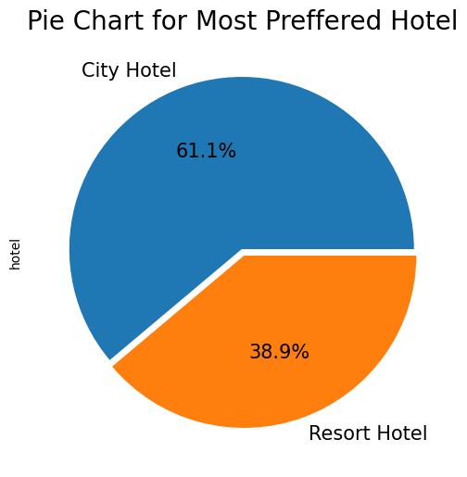
MOST PREFERED HOTEL
EXPLORATORY DATA ANALYSIS(EDA)
City Hotel is most preferred hotel by guests.
Thus city hotels has maximum bookings.

Slide 9
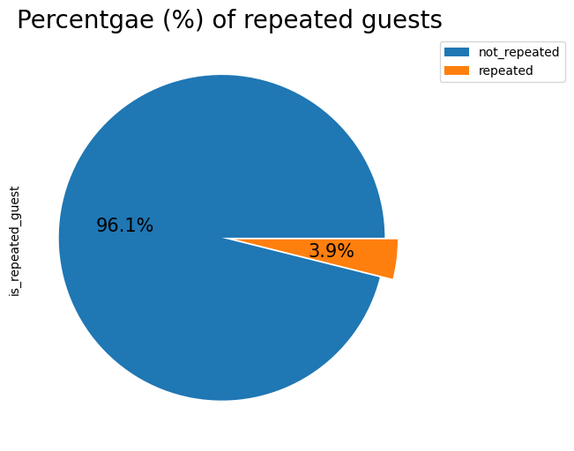
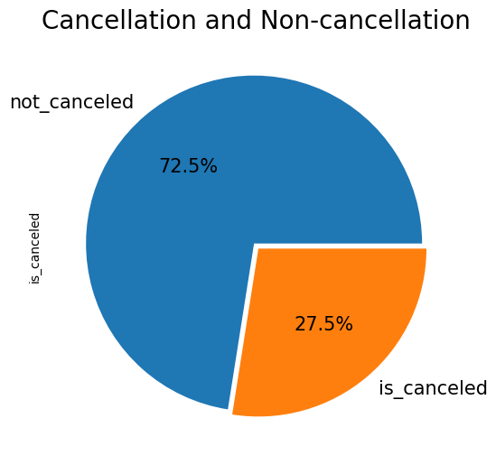
cancellation OF BOOKING
Percentage of repeated guests
Repeated guests are of few in number, and is 3.9% of total number of guest
27.5% of the booking were cancelled.

Slide 10
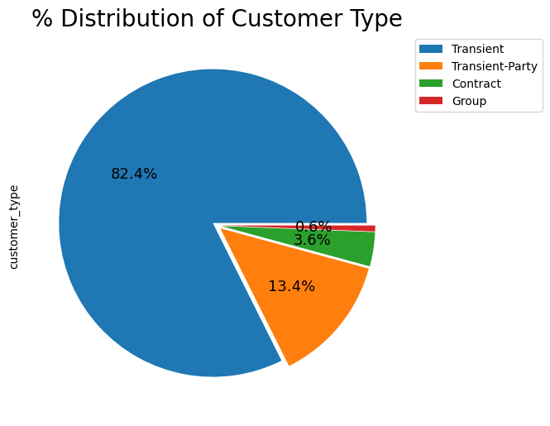
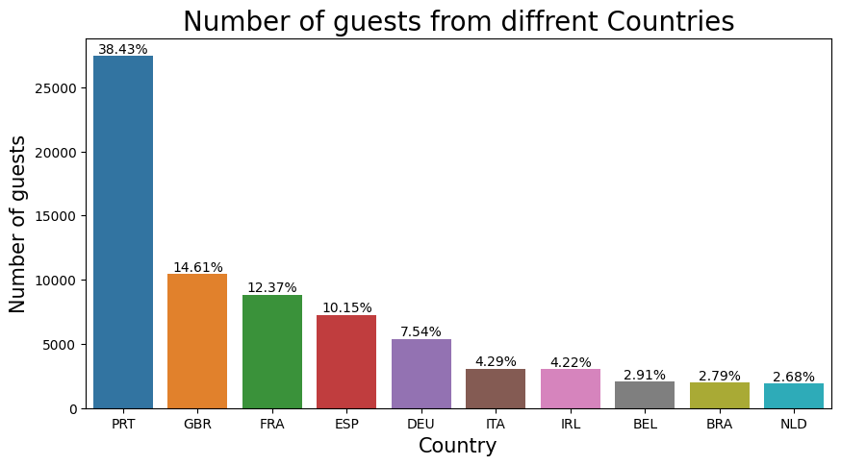
CUSTOMER TYPE
Guest from different countries
Transient customer type is more which is 82.4 %. percentage of booking associated by the Group is vey low.
Most of the guests are from Portugal, that is more than 25000 guests.

Slide 11
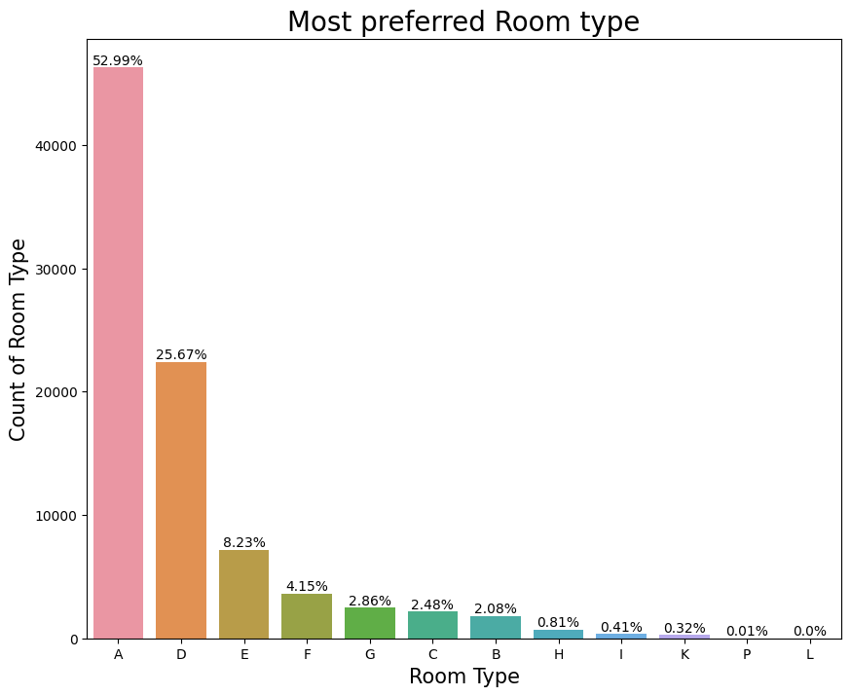
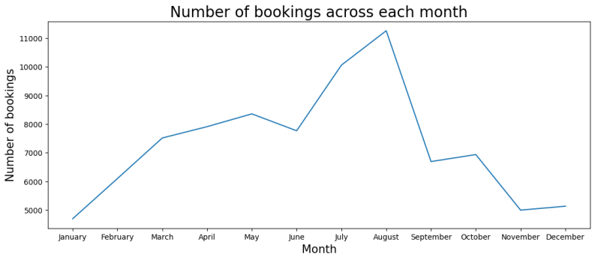
MOST PREFERRED ROOM TYPE
HIGHEST BOOKING MONTH
Most preferred room type is A.
Highest booking month is August.

Slide 12
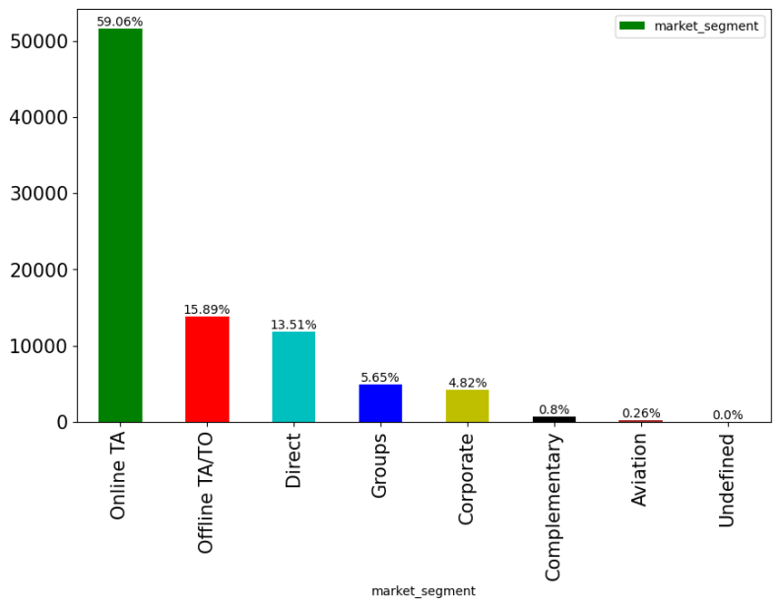
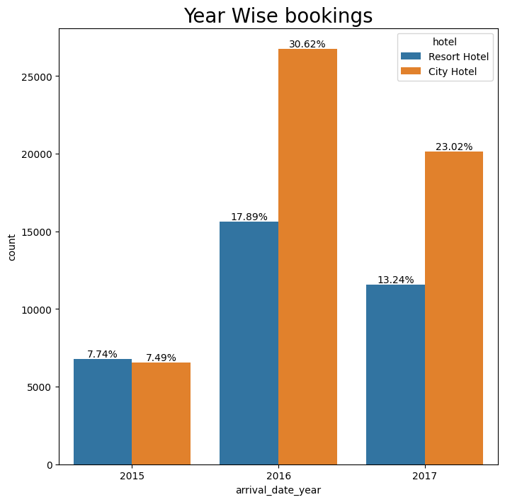
DISTRIBUTION CHANNEL USED FOR BOOKING
YEAR WISE BOOKING
The booking for city hotel have drastically increased in the year 2016 and 2017.
Most bookings are made through online TA.

Slide 13
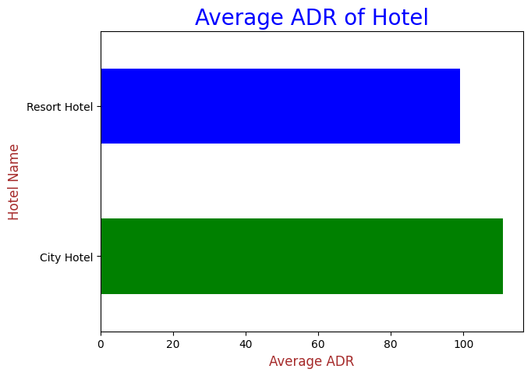
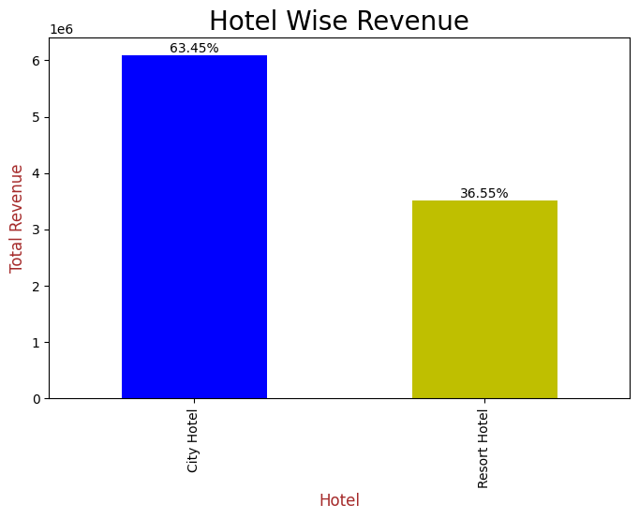
AVERAGE ADR
HOTEL WISE REVENUE
The average ADR of City hotel is higher than Resort hotel, so the profit and revenue will be higher for city hotel.
Revenue of city hotel is higher than resort hotel.

Slide 14
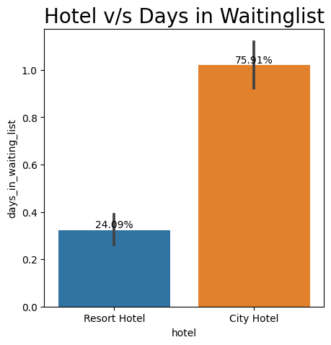
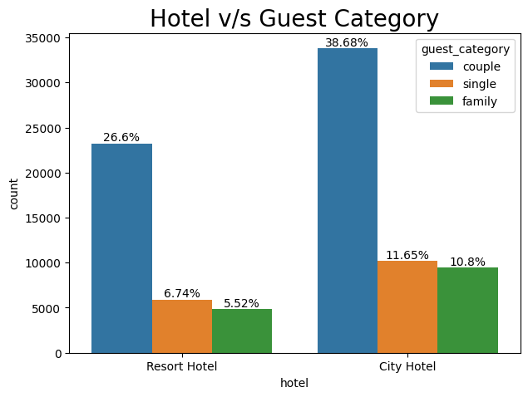
BUSIEST HOTEL
GUEST CATEGORY
Most of the bookings are done by couples. Customers prefer city hotels over resorts for family bookings. City hotel is preferred when booking for a single person.
City hotel is busier than resort hotel.

Slide 15
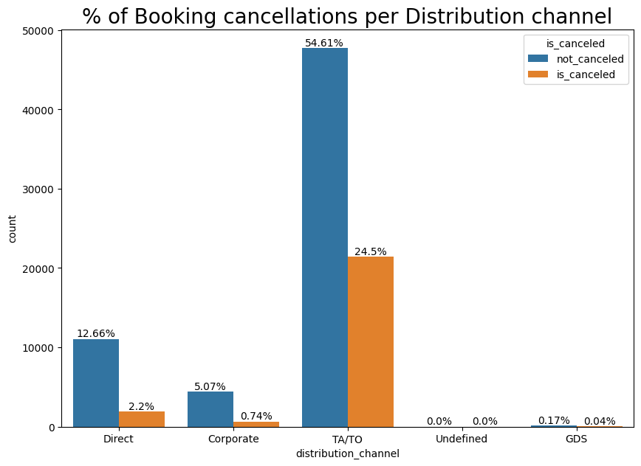
DISTRIBUTION CHANNEL WITH MOST CANCELLATION OF BOOKING
The majority of canceled bookings were made through the TA/TO distribution channel. Bookings made through the Direct, Corporate, and GDS distribution channels are extremely unlikely to be cancelled.

Slide 16
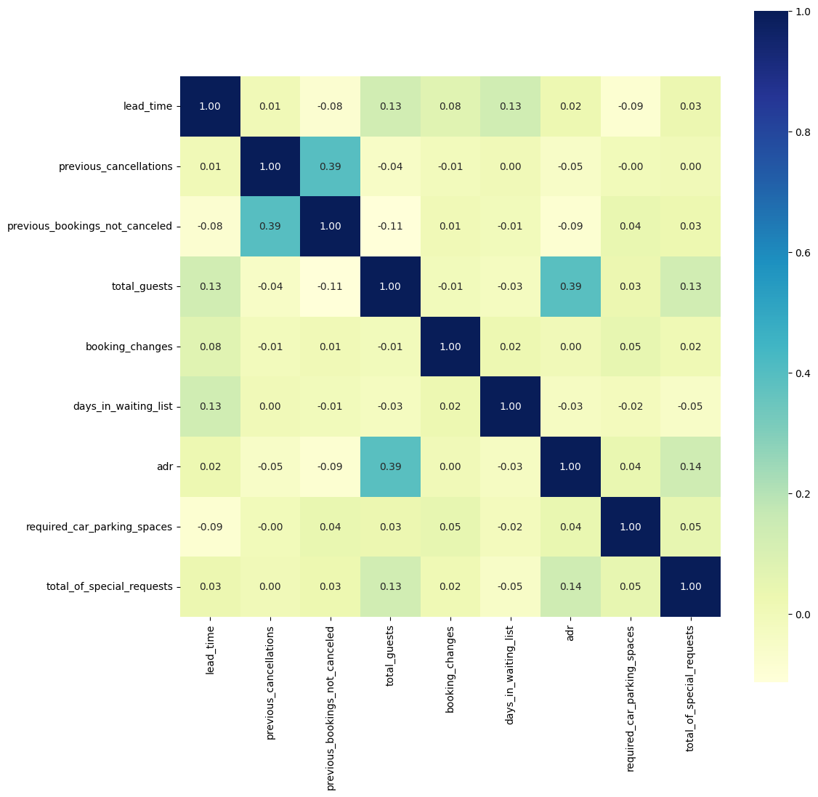
CORRELATION OF COLUMN
Highest correlation value between axis is 39% positive & lowest correlation value between the axis is -9% negative.

Slide 17
SOLUTION TO BUSINESS OBJECTIVE
The city hotel has more bookings than the resort hotel. Offer packages and promotions to promote bookings for the resort hotel
Most of the bookings are made through the online platform. Hotels can cut costs by eliminating market segments as the bookings are very low in it.
Because most bookings made through TA/TO distribution followed by corporate distribution, hotels should invest in both these channels. The GDS distribution channel can be eliminated because bookings made through it is extremely low.
Very few customers (3.86%) visited again. So hotels can increase repeat bookings by offering the right repeat booking incentives, understanding the motivations behind repeat bookings, marketing to your guests, past interests and assessing past bookings to identify priority guests.
Rooms A and D are the most popular with customers, so the hotel should always maintain their quality. To promote rooms E, F, and G they can offer discounts. As customers do not prefer to book room types B, C, H, and L, the hotel can either eliminate them or lower the cost of these rooms.
Almost 25% of customers cancelled their bookings so to reduce it hotel should implement a cancellation policy.
People typically book rooms for two people, so encourage family and group bookings. You can maximize revenue by promoting it with a discounted offer for group bookings.

Slide 18
CONCLUSION
City Hotel seems to be more preferred among travellers and it also generates more revenue & profit.
Most number of bookings are made in July and August as compared rest of the months.
Room Type A is the most preferred room type among travellers.
Most number of bookings are made from Portugal & Great Britain.
Most used distribution channel is online TA. Bookings made through the Direct, Corporate, and GDS distribution channels are extremely unlikely to be cancelled.
City Hotel retains more number of guests.
Around one-fourth of the total bookings gets cancelled.
Booking in city hotel increased drastically and is the busiest hotel compared to resort hotel.

